Slide 1
HPV Prevalence Data – Exploration & Missing Data Analysis
SAINATH R
NIT Raipur
May 30, 2025
HPV Prevalence Data – Exploration & Missi
ng
May 30, 2025

Slide 2
Project Background & Replication
Previous intern: Daljeet used XGBoost on HPV prevalence data. Target Variables: ncc combined, high cin combined,
ncc 16 prevalence, etc.
I successfully replicated Daljeet’s results for all target variables.
Daljeet dropped many prevalence, pregnancy, and case-related features.
HPV Prevalence Data – Exploration & Missi
ng
May 30, 2025

Slide 3
Daljeet’s Setup (ncc combined)
Model: XGBoost Regressor
Dropped Features: All prevalence & cases related Parameters:
eta=0.05, max depth=3, gamma=0.3 min child weight=4, subsample=1.0
colsample bytree=0.7, lambda=2.0, alpha=1.0
Test R² = 0.5281
HPV Prevalence Data – Exploration & Missi
ng
May 30, 2025

Slide 4
My Replication: ncc combined
Dropped only target-related columns. Model: XGBoost
Test R²: 0.7416
HPV Prevalence Data – Exploration & Missi
ng
May 30, 2025

Slide 5
High CIN Combined: Comparison
Metric | Daljeet | Me
Train MSE | 33.3991 | 0.0024
Train R² | 0.4095 | 1.0000
Test MSE | 172.7375 | 5.6040
Test R² | -0.1423 | 0.9412
HPV Prevalence Data – Exploration & Missi
ng
May 30, 2025

Slide 6
My Model Parameters (High CIN Combined)
colsample bytree=1.0, learning rate=0.1 max depth=4, min child weight=3
n estimators=200, reg alpha=0, reg lambda=1 subsample=0.7
HPV Prevalence Data – Exploration & Missi
ng
May 30, 2025

Slide 7
NCC-16 Prevalence: Comparison
Metric | Daljeet | Me
Train R² | 0.8687 | 0.9932
Test R² | 0.8033 | 0.7416
HPV Prevalence Data – Exploration & Missi
ng
May 30, 2025

Slide 8
My Parameters (ncc 16 prevalence)
colsample bytree=1.0, learning rate=0.1 max depth=4, min child weight=3
n estimators=100, reg alpha=1, reg lambda=1 subsample=0.9
HPV Prevalence Data – Exploration & Missi
ng
May 30, 2025

Slide 9
Daljeet Parameters (ncc 16 prevalence)
gamma = 0.9773, min child weight = 4 subsample = 0.9999, colsample bytree = 0.5012 colsample bylevel = 0.9995
lambda = 9.9672, alpha = 0.0050
HPV Prevalence Data – Exploration & Missi
ng
May 30, 2025

Slide 10
Additional Contributions
Scraped data for:
Region-wise HPV prevalence in India.
Top cities with high cervical cancer incidence.
This enriched the dataset and gave potential for future regional model training.
HPV Prevalence Data – Exploration & Missi
ng
May 30, 2025

Slide 11
Learning Difficulty Calculation (Resampling Strategy)
This function estimates how hard it has been to learn a sample i over time.
Inputs:
y_{true}: Actual label
pred hist: List of predictions for the sample across training iterations
Logic:
For each iteration t:
Compute previous error: |pred_{t−1} − y_{true}|
Compute current error: |pred_{t} − y_{true}|
If error reduced ⇒ learning; else ⇒ unlearning
Track total learning and unlearning over time
Difficulty Score:
c + Total Unlearning
Difficulty =
c + Total Learning
c is a small constant to avoid division by zero
HPV Prevalence Data – Exploration & Missi
ng
May 30, 2025

Slide 12
Results: NCC Combined
Train Performance:
RMSE = 3.0413
R² = 0.8049
Test Performance:
RMSE = 4.4
R² = 0.7379
HPV Prevalence Data – Exploration & Missi
ng
May 30, 2025

Slide 13
Results: NCC 16 Prevalence
Train Performance:
RMSE = 6.4223
R² = 0.6445
Test (Gold Standard) Performance:
RMSE = 7.3066
R² = 0.2527 ± 0.6200
HPV Prevalence Data – Exploration & Missi
ng
May 30, 2025

Slide 14
Results: High CIN 16 Prevalence
Train Performance:
RMSE = 10.1983
R² = 0.4931
Test (Gold Standard) Performance:
RMSE = 9.6869
R² = 0.2073
HPV Prevalence Data – Exploration & Missi
ng
May 30, 2025

Slide 15
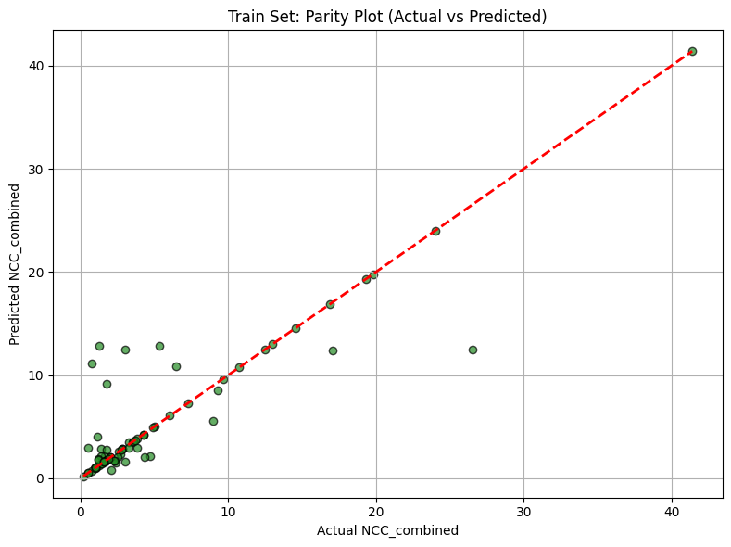
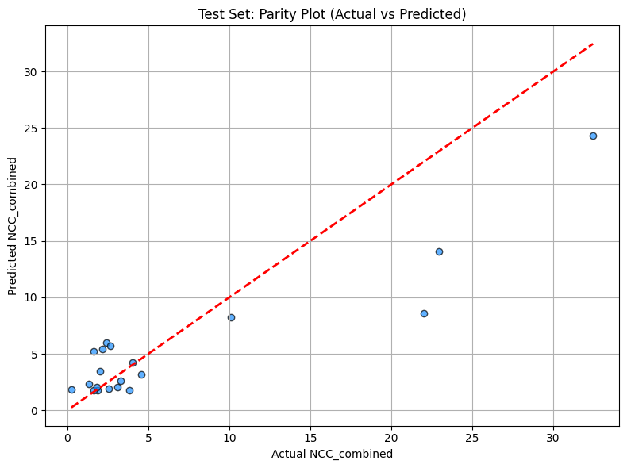
parity plot: NCC Combined
HPV Prevalence Data – Exploration & Missi
ng
May 30, 2025

Slide 16
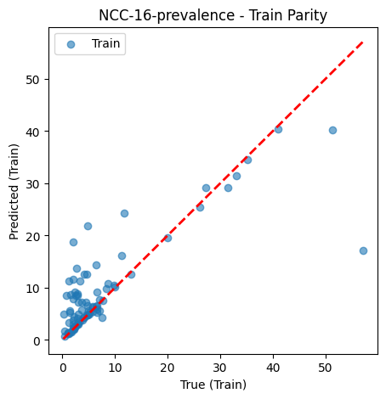
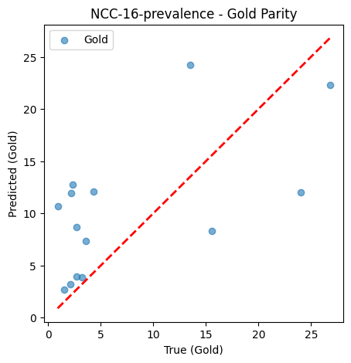
parity plot: NCC 16 Prevalence
HPV Prevalence Data – Exploration & Missi
ng
May 30, 2025

Slide 17
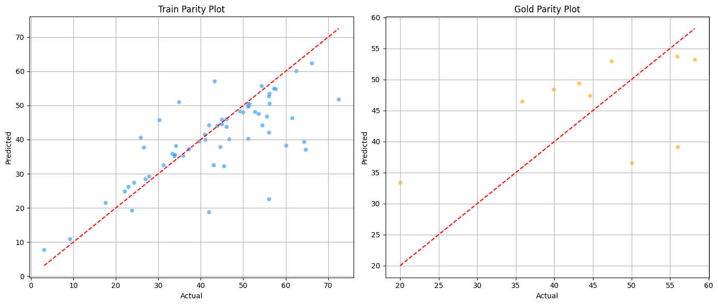
parity plot: High CIN 16 Prevalence
HPV Prevalence Data – Exploration & Missi
ng
May 30, 2025

